Slide 1
Course Overview
Notes:
Have notes open to, as there is information that is available for the lesson

Slide 2
Web Dev is a creative, rewarding and lucrative career

Slide 3
Digital sector is worth more than £400 million a day to UK economy

Slide 4
What are we here for?
Prepare you for a career in or around web/software development
Introduction to the code, languages, tools, frameworks and resources we use day to day
Develop the skills and knowledge you need
Help you find work
OBJECTIVES

Slide 5


Who are we?

Slide 6


Who are we?
Luke Ashton-Johnson
Frontend Web Developer
Alex Seymour
Web Developer

Slide 7
Full Course
Intro to Web Development & Source control
Programming With JavaScript
Fundamentals: HTML and CSS
Deployment & going further with your coding

Slide 8
Intro to Web Development
Introduction to course Objectives and Overview
How the web works Understanding some basic terminology and concepts
Setting up a local development environment
Self led learning Free online resources to learn code

Slide 9
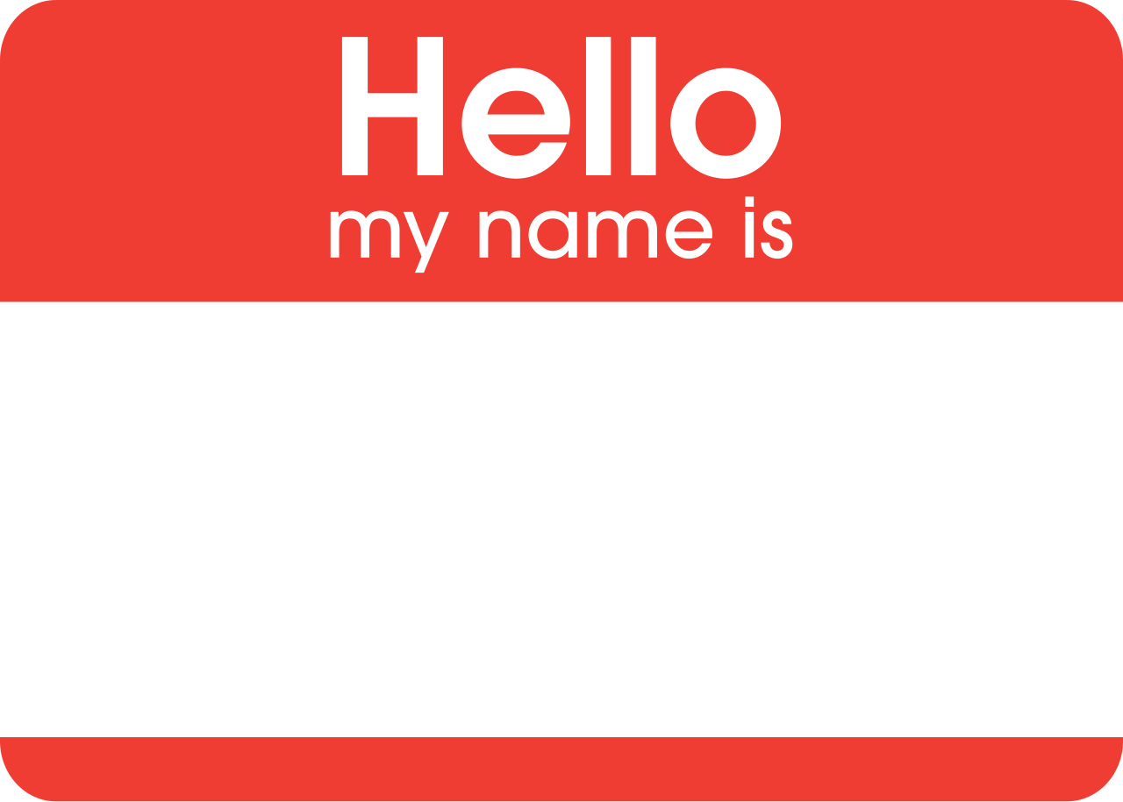

Slide 10
Introductions
Get into pairs and have a chat to find out about the other person. You’ll be introducing them to the group later.
You might like to ask:
Where they are from
Why they are here
What they hope to get from this course
10 minutes

Slide 11
Remote Version
Post a message in the group - let us all know:
Where you are from/live
What you are doing for a living right now
What you hope to get out of this course
Anything else...
On MS Teams

Slide 12
Why choose a career in Web Development?

Slide 13
Digital sector contributed over £150 billion to the UK economy in 2015
Sector accounts for 7.7 per cent of the UK economy as a whole
Growth in the sector is nearly six times larger than growth across the economy as a whole

Slide 14
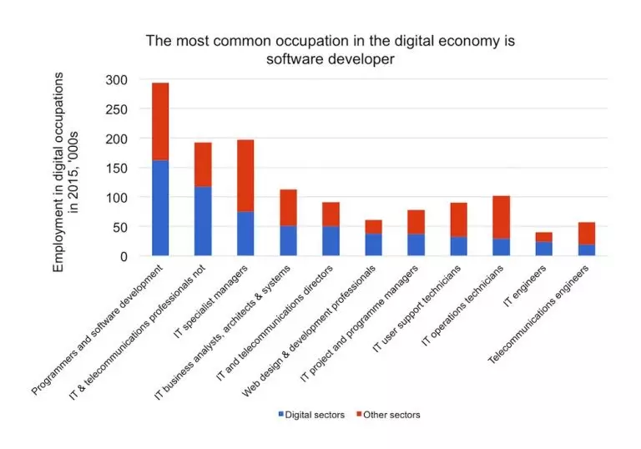

Slide 15
83%
Employers say their biggest difficulty is recruitment
said finding talented individuals was their most common challenge
https://technation.io/insights/report-2018/

Slide 16
10 - 15%
Being a web developer is only
<Code />

Slide 17
We need to learn
Code Skills
Core Skills
Tools
Concepts

Slide 18
So Let’s Get Started

Slide 19
What do web developers do?
In short, web developers build and maintain websites.
Web developers often work for clients who are trying to get their product or service onto the web. The work is typically very project focused and involves collaborating with a team that helps to coordinate the client’s needs into the end product. The client could be a tech company, an organisation, or a government. The work could involve front-end, back-end, or full-stack web development.
Notes:
Closing : Web development could be a good profession for you if you like solving logical problems, building useful things, and experimenting with new technologies. Web developers are in high demand, generally have a good work/life balance, and command comfortable salaries. Google your specific location to get a better sense of your local web development job opportunities..
For more details, Wikipedia describes the breadth of the web development profession in their entry on web design

Slide 20
Types of Web Developers
Front End
Back End
Full-Stack
Notes:
Earlier, we mentioned that web development work could be in the front end, the back end, or the full stack. What exactly do these terms mean?
The front end is the stuff you see on the website in your browser, including the presentation of content and user interface elements like the navigation bar. Front-end developers use HTML, CSS, JavaScript, and their relevant frameworks to ensure that content is presented effectively and that users have an excellent experience.
The back end refers to the guts of the application, which live on the server. The back end stores and serves program data to ensure that the front end has what it needs. This process can become very complicated when a website has millions of users. Back-end developers use programming languages like PHP, Python, and Java to work with data.
Full-stack developers are comfortable working with both the front and back ends.

Slide 21
Types of Careers
Large tech companies, such as Google, Facebook, and Amazon, have very stringent hiring requirements. If you successfully meet these expectations, they offer excellent pay, benefits, and opportunities.
Startups are a bit like the wild west. For a junior developer, it can feel like a trial by fire because of the pace of development. Startups often offer slightly lower salaries and require longer hours, but they may also offer equity in the company and highly unique environments.
Notes:
Opening : Now that you know about the different types of web developers, let’s cover what we mentioned earlier about the different types of clients and employers you may work with.

Slide 22
Types of Careers Contd.
As a freelancer, you could command a strong hourly wage and the freedom to schedule and design your own products. However, you would be responsible for getting your own work (which means less coding time), managing billing from clients (which can be difficult), and being solely responsible. Strong people skills are necessary for this path.
As a consultant for a web consultancy, you would give up some of your freelancing wage potential but be able to focus more on the code and less on the hustle. This option also provides a good work/life balance and pay.
Notes:
Closing : Finally, large, older companies still need web developers. These companies offer a good work/life balance, pay, and benefits but often move slower than a company that is highly focused on tech.

Slide 23
Tools of the Trade
Computer
Google
Text Editor
Command Line Interface (CLI) - GitHub Desktop Application
Stack Overflow
Git
GitHub
Notes:
Opening : These are some of the basic tools you will use regularly. You may not know what they are now, but you most certainly will going forward.

Slide 24
Motivation
Notes:
Opening: Learning to code is incredibly rewarding but can also be difficult and frustrating. The strongest assets you can have as a student are a desire to build, a problem-solving mind, and persistence in the face of setbacks.
The web development industry has a long history of successful developers with varying backgrounds, so people tend to care more about what you’ve actually built than how you got there.

Slide 25
Conclusion
Notes:
Opening: Hopefully, you’ve gained a better idea of what a web developer actually does and what your life might look like if you decided to take it on as a career. This has only been a teaser into the world of web development.
Closing :
Go to freeCodeCamp and create an account,
Talk about the overall curriculum,
Run through the first couple of lessons with the delegates.
Sign up to Github and create a repo named after their username, initialize with a readme.
Get the students to: Add each other and yourself.

Slide 26

Take away Tasks
Watch:
Internet Fundamentals
Terminology Section
Prerequisites
Notes:
http://internetfundamentals.com/watch/

Slide 27
Any Questions?

